Slide 1
Preventing Diabetes:
The National Diabetes Prevention Program as a Covered Benefit

Slide 2
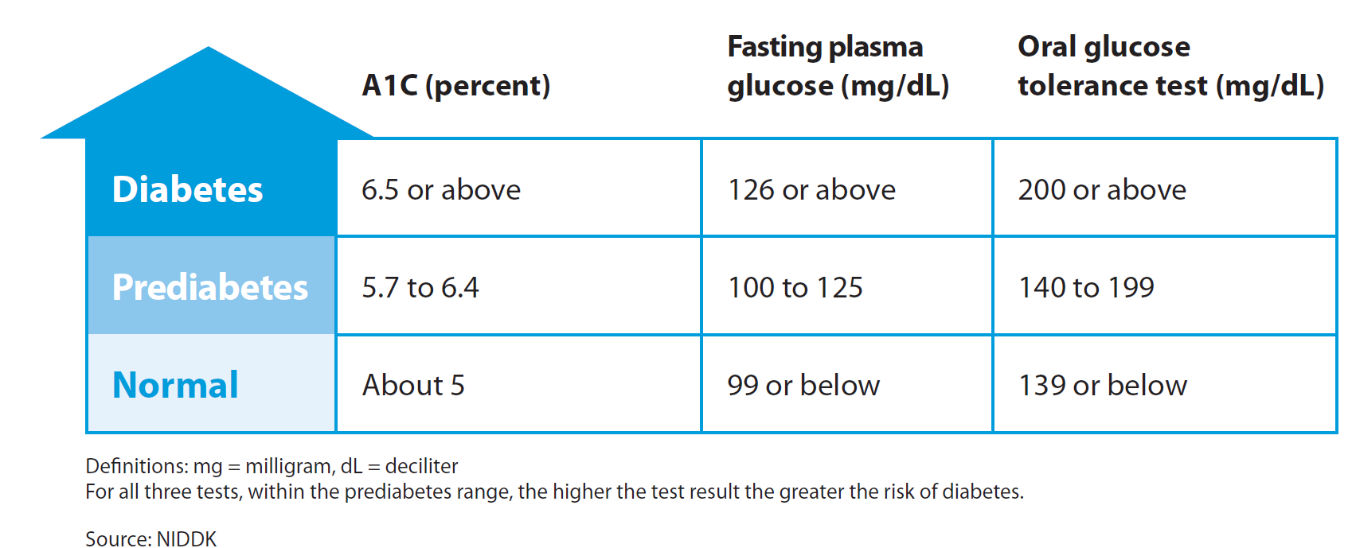

Prediabetes: Targeting a population at risk
  Prediabetes: A reversible cardio metabolic risk factor in which plasma glucose levels are above normal but not high enough to diagnose type 2 diabetes. It is defined as having an initial A1c result between 5.7 and 6.4%, or other blood tested noted below and no prior diabetes diagnosis †,‡
  3-5 times higher risk of developing type 2 diabetes*
  Increased risk of cardiovascular disease and death
29 million Americans have diabetes*
86 million American adults have prediabetes*
That’s more than 1 in 3 adults
9 out of 10 adults with prediabetes don’t know they have it
*Source: Centers for Disease Control and Prevention. National diabetes statistics report: estimates of diabetes and its burden in the United States, 2014. Atlanta, GA:
US Department of Health and Human Services, Centers for Disease Control and Prevention, 2014.
†American Diabetes Association. “Standards of medical care in diabetes—2013.” Diabetes Care (2013); 36:Suppl 1:S11.
‡James C, Bullard KM, Rolka DB, et al. “Implications of alternative definitions of prediabetes for prevalence in US adults.” Diabetes Care 2011; 34(2):387-391.

Slide 3
Evidence-based National Diabetes Prevention Program (National DPP)*
National Institute of Health (NIH)-funded 3-arm Randomized Control Trial
Placebo | Metformin | Intensive lifestyle coaching
5-7% body weight loss reduced the risk of developing Type 2 diabetes by 58% in those with prediabetes (over 3 years)
71% in those over age 60
*Knowler WC, Barrett-Connor E, Fowler SE, et al. Diabetes Prevention Program Research Group. Reduction in the incidence of type 2 diabetes with lifestyle intervention or metformin. N Engl J Med. 2002;346(6):393-403.

Slide 4
National Diabetes Prevention Program
Based on the NIH-funded research, the CDC-approved, evidence-based National Diabetes Prevention Program aims to slow and prevent the development of Type 2 diabetes in the US population
  Lay and health professional lifestyle coaches teach in-person or virtual group classes of 8-15 participants
  Comprehensive program focused on weight loss through exercise, healthy eating and behavior modification
16 Sessions
Core phase (6 months)
Maintenance phase (6 months)
Monthly maintenance sessions
Examples of topics covered in core curriculum include:
  1. Balancing calories 4. Strategies for healthy eating out
Problem solving/coping 5. Social cues
Overcoming physical activity barriers 6. Managing stress

Slide 5
Potential benefits of offering the National DPP
Offering the National DPP helps achieve better clinical and financial results over 3 years
(after program completion).
Based on the outcomes from DPP research studies reaching 100 adults with prediabetes:
  58% reduction in incidence of diabetes*
  25% reduction in medication use for hypertension and hyperlipidemia‡
  1-2% reduction in absenteeism (missed work days) and productivity loss†
*Knowler WC, Barrett-Connor E, Fowler SE, et al. Diabetes Prevention Program Research Group. Reduction in the incidence of type 2 diabetes with lifestyle intervention or metformin. N Engl J Med. 2002;346(6):393-403.
† Dall, Timothy M., et al. “Value of Lifestyle Intervention to Prevent Diabetes and Sequelae.” American journal of preventive medicine 48.3 (2015): 271-280.
‡ Ratner R, Goldberg R, Haffner S, et al. Impact of intensive lifestyle and metformin therapy on cardiovascular disease risk factors in the diabetes prevention program. Diabetes Care. 2005;28(4):888- 894.

Slide 6
Potential cost savings from offering the National DPP
The American Medical Association (AMA) evaluated the Truven Health MarketScan® Databases*
to understand the avoidable medical expenditures over three years by preventing someone from progressing to diabetes:
  Observed the costs associated with an individual’s conversion to diabetes for each of three years after a diabetes diagnosis
  Looked at a “true” prevention rate for intervention – some individuals would have never developed diabetes and some will develop diabetes regardless
  Defined prediabetes as having an initial A1c result between 5.7 and 6.4% and no prior diabetes diagnosis †,‡
Preventable
Avoidable
Year 1 | 53%
Year 2 | 28%
Year 3 | 19%
Year 1 | $2,470
Year 2 | $3,190
Year 3 | $2,350
Observed rate of prediabetes to diabetes conversion:
Increased costs in each of three years after converting:
e.g., 53% of those who converted to diabetes over a three year period actually convert in year one.
Medical claims costs associated with newly diagnosed diabetes
*2009-2012 individual level data from the Truven Health MarketScan® Lab Database - a 4.4 million subsample of the Truven Health MarketScan® Treatment Pathways. MarketScan is a registered trademark of Truven Health Analytics Inc.
†American Diabetes Association. “Standards of medical care in diabetes—2013.” Diabetes Care (2013); 36:Suppl 1:S11.
‡James C, Bullard KM, Rolka DB, et al. “Implications of alternative definitions of prediabetes for prevalence in US adults.” Diabetes Care 2011; 34(2):387-391.
These calculator results are provided to you by the American Medical Association for informational purposes only.
No return on investment or other results are guaranteed.

Slide 7
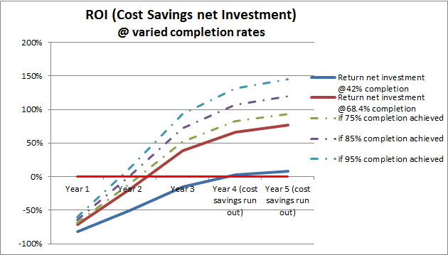
Potential return after offering the National DPP
Using the AMA’s DPP cost savings calculator, the potential cumulative net savings after investment for your population could be:
COPY AND PASTE IMAGE #1 FROM CALCULATOR RESULTS
(return graph)
These savings consider:
  Investment cost of the National DPP in year 1 (per enrollee)
  Projected prevention rate
  Avoided claims costs (savings) for each of three years based on prevention rate
  Cost savings “run out” for cases prevented in year 3
These calculator results are provided to you by the American Medical Association for informational purposes only.
No return on investment or other results are guaranteed.

Slide 8
Potential cost savings of offering the National DPP
The inputs used to model our population in the cost savings calculator include:
COPY AND PASTE IMAGE #2 FROM CALCULATOR RESULTS
(summary of inputs)
These calculator results are provided to you by the American Medical Association for informational purposes only.
No return on investment or other results are guaranteed.

Slide 9
Potential cost savings of offering the National DPP
Based on the inputs that are appropriate for our population, the potential cost savings, cumulative cost savings and net savings after investment:
COPY AND PASTE IMAGE #3 FROM CALCULATOR RESULTS
(summary of cost outputs)
These calculator results are provided to you by the American Medical Association for informational purposes only.
No return on investment or other results are guaranteed.

Slide 10
Improving potential return: Key levers
The following are key levers that drive the impact the National DPP could have for your population.
Increase participant completion rate
Align costs to outcomes
Offer individual incentives/align to benefit design
Choose a local, in-person and/or virtual National DPP to connect with participants where they live/work
Explore outcomes-based payment models, which correlate payment with participant achievement of weight loss milestones
Discuss benefit design with National DPP provider
Work with National DPP provider to engage participants throughout the program
Consider AMA tools for physicians to discuss the program with their patients

Slide 11
Additional benefits to consider
In addition to medical claims savings, there are additional potential benefits that are not included in the AMA cost savings calculator that may be pertinent for your business case.
Medical expenditures and claims costs
  Long-term impact of the National DPP beyond three years
  Incremental impact of the National DPP for those that enroll but do not complete
Incidence/prevalence
  A dynamic model that includes influx of new individuals who may be at risk
  Impact of the National DPP on other co-morbidities
Productivity
  Increased productivity and reduced absenteeism

Slide 12
Cost of the National DPP
The cost of covering the National DPP is less than the medical claims incurred in the first year after an individual is diagnosed with diabetes:
Diabetes costs approximately $2,700 per individual with newly diagnosed diabetes in the first year of treatment*
Individuals with prediabetes have a 15% to 30% chance of developing type 2 diabetes within five years†
As an intervention to prevent diabetes, the National DPP costs
An average of $450 per participant for a year
Payment models vary
Alternatively…
*2009-2012 individual level data from the Truven Health MarketScan® Lab Database - a 4.4 million subsample of the Truven Health MarketScan® Treatment Pathways. MarketScan is a registered trademark of Truven Health Analytics Inc.
† Centers for Disease Control and Prevention. National Diabetes Statistics Report: Estimates of Diabetes and Its Burden in the United States, 2014. Atlanta, GA; 2014. Available at: http://www.cdc.gov/diabetes/pubs/statsreport14/national-diabetes-report-web.pdf

Slide 13
Availability of National DPPs
Programs with or seeking CDC recognition are available around the country. The CDC recognition program is critical to ensure program quality and fidelity.
Both in-person and virtual National DPPs are available.
For more information, visit
www.diabetesfreenc.com

Slide 14
Cover the National DPP for your population
Review your health care claims data – estimate the size of your population with prediabetes to understand the potential impact of prevention
Use the AMA’s calculator to estimate the potential medical claims cost savings of offering the National DPP https://ama-roi-calculator.appspot.com/
Find a National DPP provider – talk to them about options to bring the program to your employees https://www.diabetesfreenc.com
Talk to your insurance carrier/claims administrator about covering the program

Slide 15
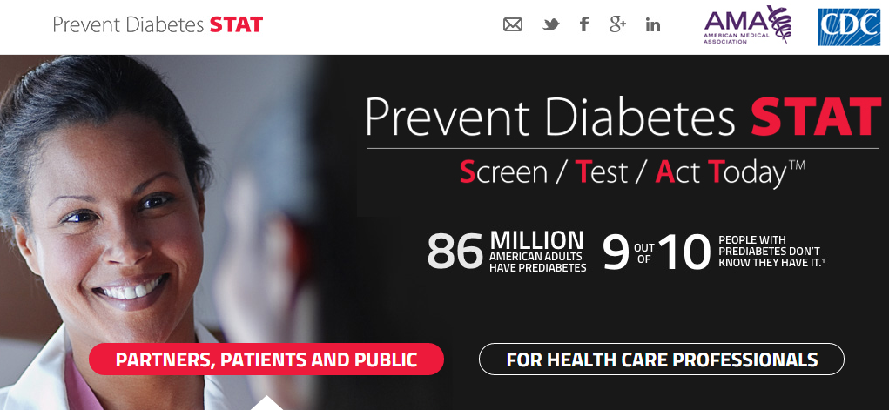
Join the AMA-CDC initiative to increase the use of National Diabetes Prevention Programs
PreventDiabetesStat.org

